Slide 1
More on Estimator Design and Duality
Observability matrix of observer canonical form
  Controllability matrix of control canonical form
Designing estimators for systems in observer canonical form
  Transformation method
Duality

Slide 2
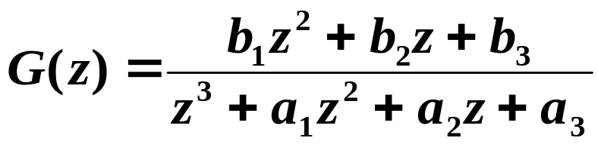
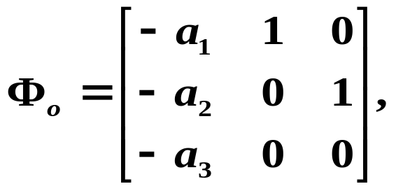
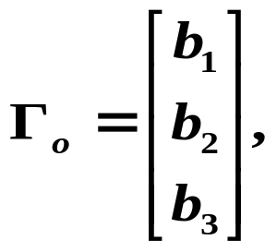


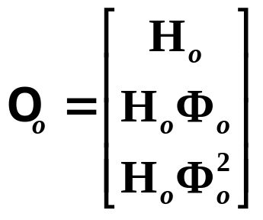
Observability Matrix Example
Example:
Find O for the following 3rd-order system
in observer canonical form.

Slide 3
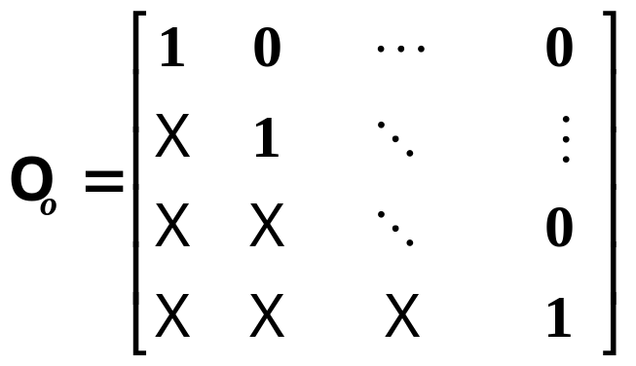
General n^{th}-order observer canonical form system has O:
What is the controllability matrix of a system in control canonical form?

Slide 4
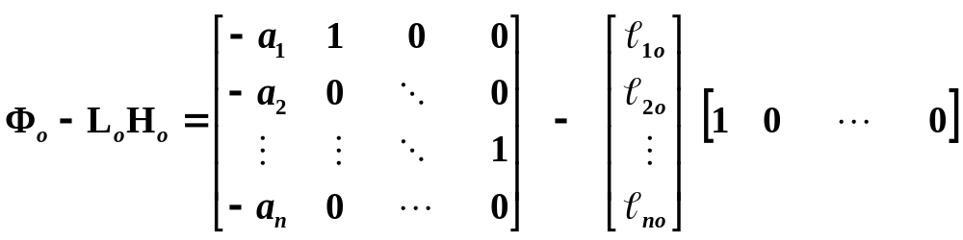
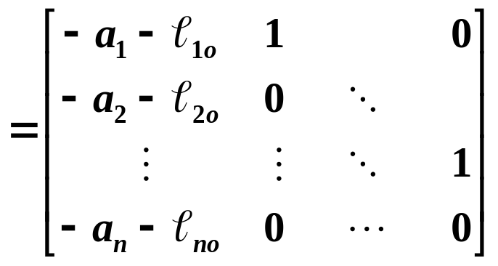
Estimator Design for Systems in Observer Canonical Form
Closed-loop estimator system matrix:

Slide 5
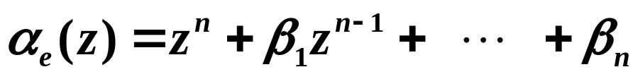
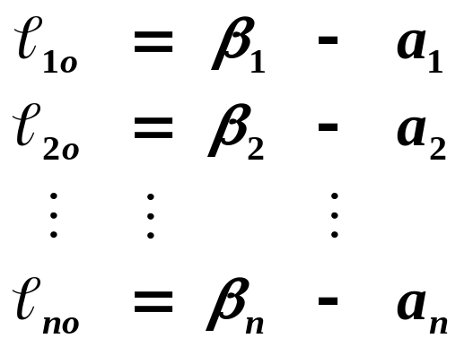
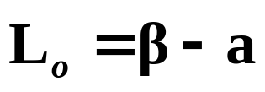
Match coefficients with desired characteristic equation:

Slide 6



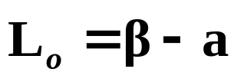
Transformation Method
So another way to design L (besides the Matching Coefficients Method) is to transform system to observer canonical form, compute L_{o} , and then transform back.
Find T :
Estimator gain vector for observer canonical form:
Transform back.
What is the transform matrix T ?

Slide 7





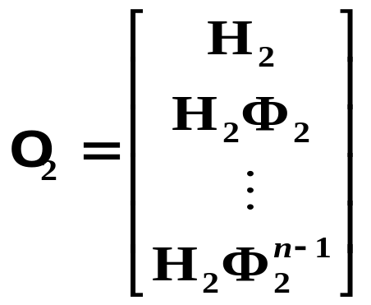


Recall the transform matrix T to control canonical form:
Does similarity transformation affect observability?

Slide 8




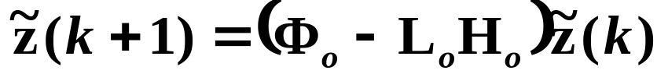
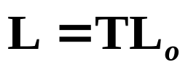
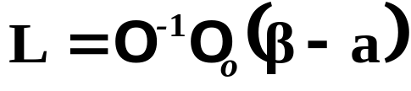
Transformation Method Formula
Find L such that
Then we have:

Slide 9
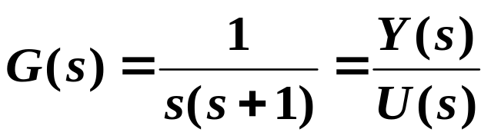

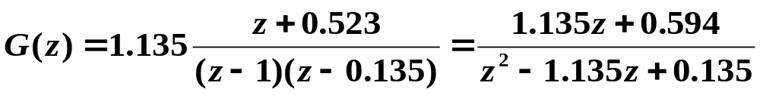
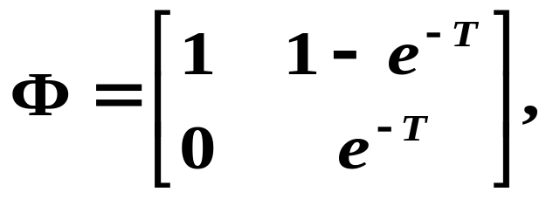
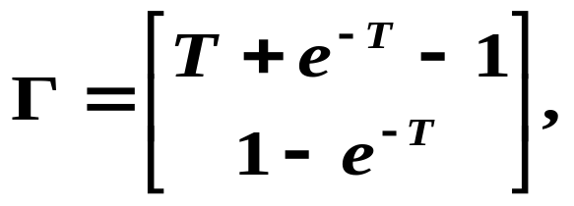


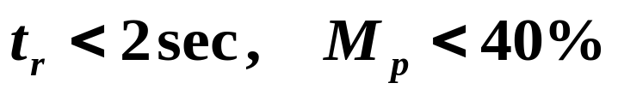
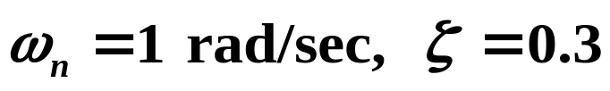
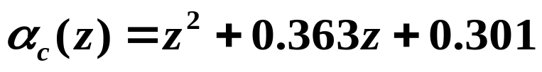

Example
Desired performance:
Designed K:
If the states are not all available (measured), we need to design an estimator.

Slide 10
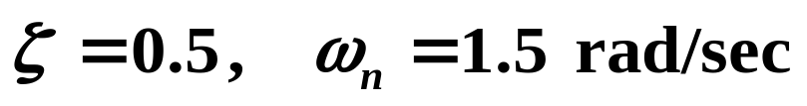
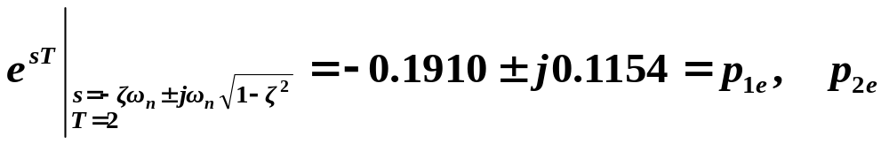
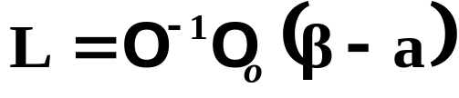
Estimator Design
Choose estimator poles to be faster:

Slide 11
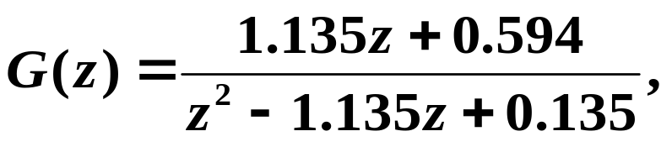

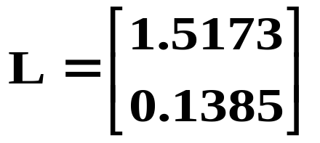

Slide 12
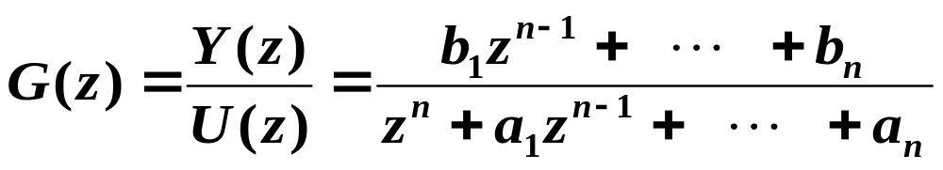
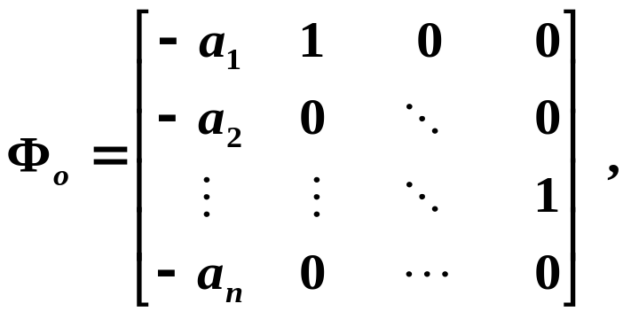
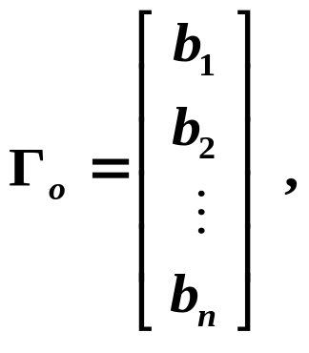
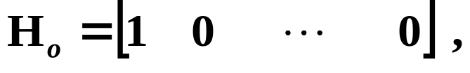

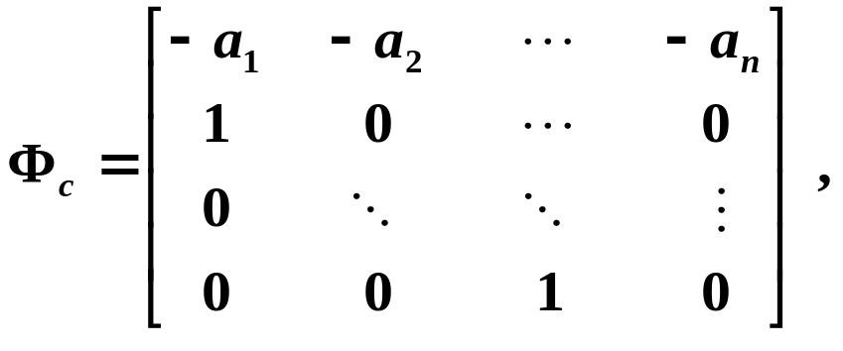
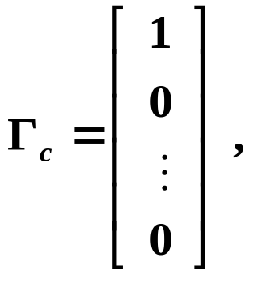



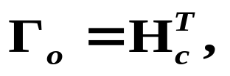
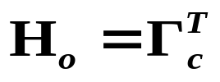
Duality
Given
Observer canonical form:
Control canonical form:
Canonical forms are dual:

Slide 13


If system is controllable, its dual form
is observable.

Slide 14



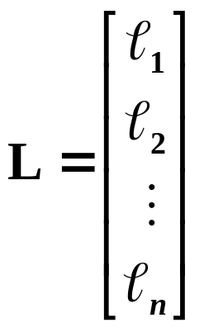


Control Problem
Find:
the eigenvalues of are satisfactory.
satisfactory poles.
Estimator Problem
Find:
the eigenvalues of are satisfactory.
satisfactory poles.

Slide 15
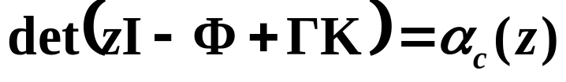
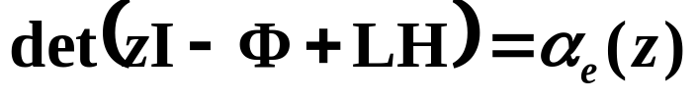
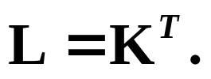
The algebra to solve the two problems is the same.
If we have an algorithm to solve the control problem:
we can use the same algorithm to solve the estimator
problem:
Solve for K , let

